Slide 1
Coffee Shop DB
CS-GY 6083 Databases | Spring ‘25
Final Project
Presented By: Esteban Lopez
May 2025
Notes:
"Hi everyone, my name is [Your Name], and welcome to my final project presentation for CS-GY 6083 Databases. I've developed a comprehensive Coffee Shop Management System designed to simulate and manage key operational data.
The goal was to build a robust system handling sales, inventory, employees, customers, loyalty points, and promotions. The technical foundation is a MySQL relational database for the backend, managed through an interactive web application built locally using Python and the Streamlit framework."

Slide 2

Agenda
01
Section

Slide 3
Agenda
Project Goal & Overview
Database Design & Key Features (ERD, Objects)
Application Technology & Structure
Live Application Demonstration (CRUD, Orders, Reports)
Database Concepts Discussion (Normalization, Integrity, Isolation)
Conclusion
Notes:
"In this presentation, I'll start with the database design and highlight some key objects created. Then, I'll briefly cover the application's structure before moving into a live demonstration of its core functionalities. After the demo, I'll discuss how key database concepts like normalization, integrity, and isolation were applied in this project. Finally, I'll conclude and open the floor for questions."

Slide 4
Database Overview
02
Section

Slide 5
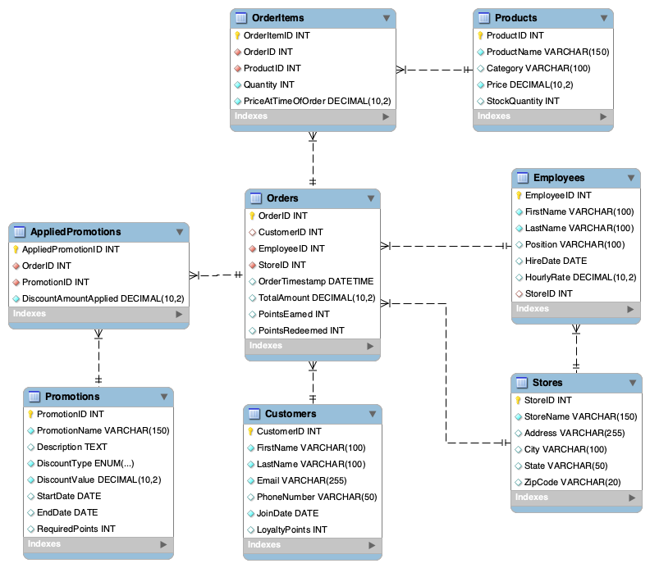
MySQL DB Foundation
0 1 . Structure
Backend powered by a MySQL relational database (coffee_shop schema).
Designed to reliably store and manage all shop data.
Features 8 tables,: (Stores, Employees, Customers, Products, Promotions, Orders, OrderItems, AppliedPromotions).
Relationships enforced via Primary and Foreign Keys.
Notes:
"The core of the system is the MySQL relational database, named coffee_shop. Here you can see the Entity-Relationship Diagram, which maps out the structure. I designed 8 tables to store information logically, covering Stores, Employees, Customers, Products, Promotions, and the crucial Orders table which links many of these together. We also have OrderItems and AppliedPromotions as junction tables to handle the many-to-many relationships effectively. This structure provides the necessary complexity and organization for the application's data."

Slide 6
DB Objects
03
Section

Slide 7

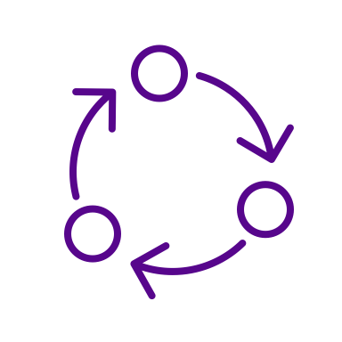


Database Object Highlights
1. Views
Simplifying data access for reporting.
2. Functions
Encapsulating reusable calculations.
3. Stored Procedures
Encapsulating business processes..
4. Triggers
Automating actions for consistency..
vw_CustomerOrderSummary
fn_GetCustomerLoyaltyPoints
sp_AddCustomer
trg_UpdateStockAfterOrder
vw_ProductSalesPerformance
fn_CalculatePointsEarned
sp_ProcessOrder
Notes:
"To meet the rubric requirements and build robust functionality, I implemented several types of database objects beyond the tables:
Two Views: vw_CustomerOrderSummary simplifies getting customer totals, while the more complex vw_ProductSalesPerformance uses joins and aggregation to calculate key sales metrics for each product, ideal for reporting.
Two Functions: fn_GetCustomerLoyaltyPoints provides a standard way to look up a customer's points, and fn_CalculatePointsEarned enforces the shop's specific rule for earning loyalty points based on spending.
Two Stored Procedures: sp_AddCustomer encapsulates the logic for adding customers safely. The core business logic resides in the complex sp_ProcessOrder procedure, which handles the entire order transaction atomically – including stock checks, item processing, point redemption, point earning calculations using the function, and database commits or rollbacks.
One Trigger: Finally, trg_UpdateStockAfterOrder automatically decreases product stock levels whenever an order item is added, ensuring inventory consistency without manual intervention in the main procedure."

Slide 8
App Tech Stack & Structure
04
Section

Slide 9
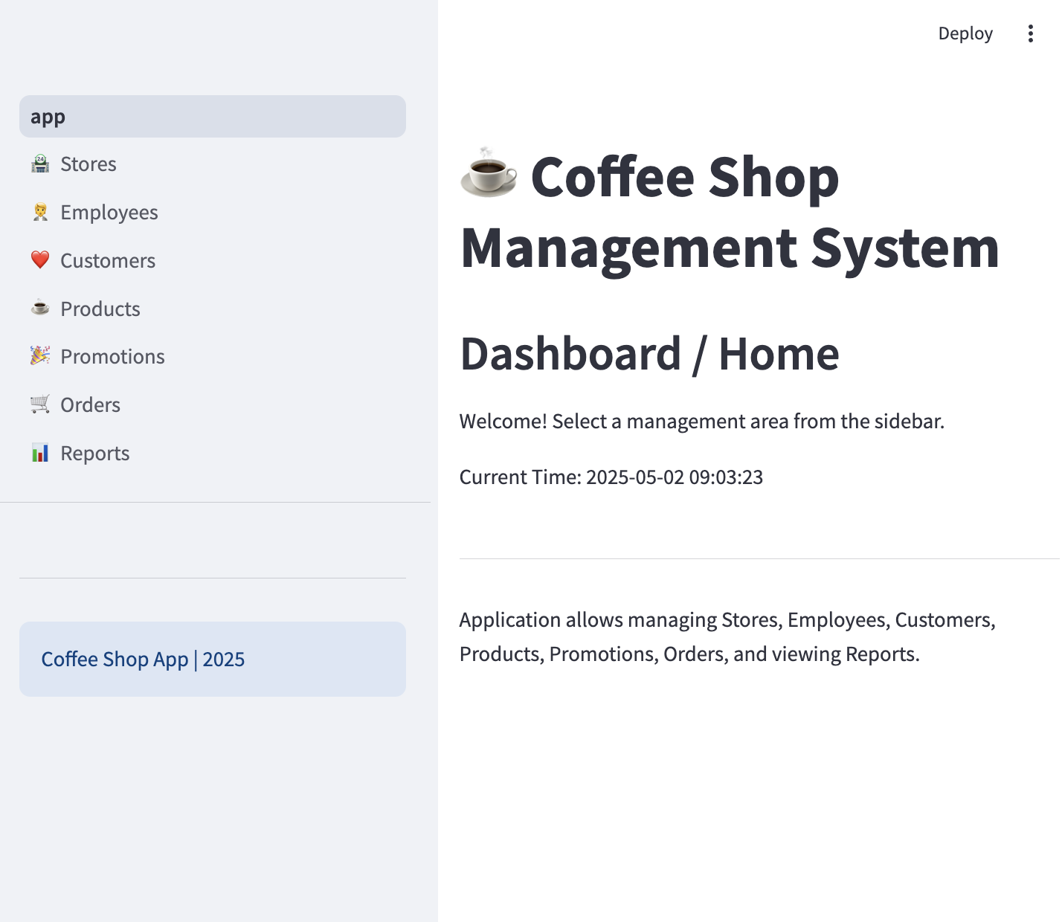
App Tech Stack & Structure
Stack:
Python, Streamlit (Web UI), PyMySQL (DB Connector)
Execution:
Runs locally.
Structure:
|-- App/
|-- pages/ # Streamlit page scripts
| |-- 01_🏪_Stores.py
| |-- 02_🧑‍💼_Employees.py
| |-- 03_👤_Customers.py
| |-- 04_☕_Products.py
| |-- 05_🎉_Promotions.py
| |-- 06_🧾_Orders.py
| |-- 07_📊_Reports.py
|-- app.py # Main Streamlit app file (Home page)
|-- database.py # DB connection & helper functions
Notes:
"The front-end interface is a web application built entirely in Python using the Streamlit framework, communicating with the MySQL database via the PyMySQL library. It's designed to run locally. The code is organized into a main app.py for the home page, a database.py module handling all SQL interactions, and a pages directory where each Python file corresponds to a navigable section in the application's sidebar."

Slide 10
Live Demo
05
Section

Slide 11
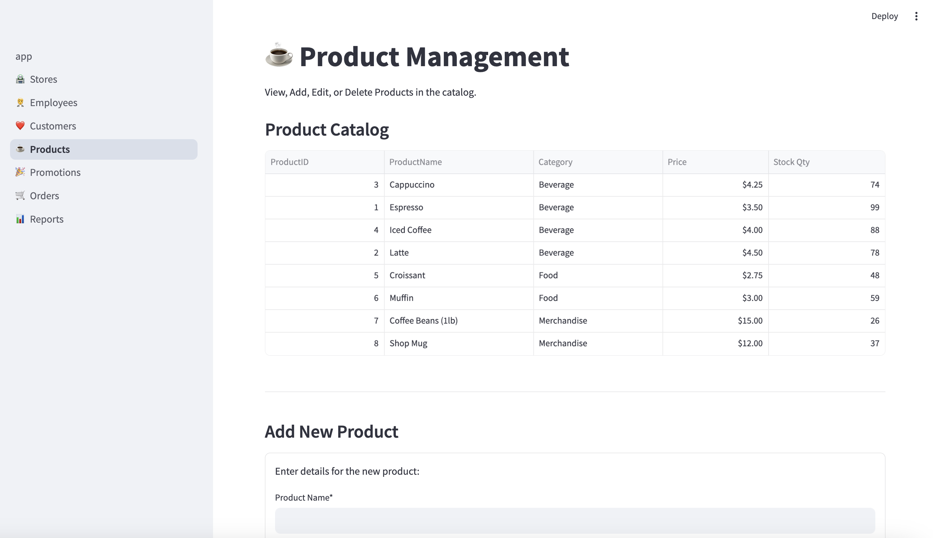
Live Demo
CRUD Operations (Products Example)
Order Creation Workflow (Items, Points, Promotions)
Order Viewing
Reports Dashboard
Notes:
"Now, I'll switch to a live demonstration to show how these components work together."
(--- Begin Screen Share / Live Demo ---)
Demo Navigation & CRUD:
(Action: Show app, sidebar) "Here's the running application. The sidebar allows navigation between modules like Stores, Employees, Customers, Products..."
(Action: Go to Products page) "Let's look at Products. This page reads from the Products table using the run_query function and displays it."
(Action: Use 'Add New Product' form, fill details, click Add) "We can add a new product..." (point out success message, new item in table) "...which calls run_command to execute an INSERT statement."
(Action: Select the new product in 'Edit' dropdown, change price, click Update) "We can also edit existing products..." (point out success message, updated price in table) "...triggering an UPDATE statement."
(Action: Point to Delete section) "Delete functionality is also implemented, respecting database constraints. This CRUD pattern is available for Stores, Employees, Customers, and Promotions as well, fulfilling that rubric requirement."
Demo Order Creation:
(Action: Go to Orders -> Create New Order tab) "The core workflow is creating an order."
(Action: Select Employee, Store, a registered Customer) "We select the staff member, store, and customer - notice the 'Points to Redeem' input enables when a customer is chosen."
(Action: Add 2-3 different items using the 'Add Item' section) "Items are added dynamically to the order list below; stock levels are checked here using data fetched earlier."
(Action: Enter points in 'Points to Redeem' input) "The customer can redeem points..."
(Action: Select an active promotion from the multiselect box) "...and we can apply currently active promotions manually."
(Action: Click 'Process Order') "Clicking 'Process Order' initiates the main transaction."
(Voiceover during/after processing) "This calls the sp_ProcessOrder procedure in MySQL which validates stock, inserts order/items, updates points, and commits atomically. Afterwards, the Python code calculates and applies the selected promotion's discount, updates the final total, and records the applied promotion."
(Action: Show success message with Order ID and applied promo)
Demo Order Viewing & Reports:
(Action: Switch to 'View Past Orders' tab, find the new order) "We can then view the newly created order..." (optionally click to show items).
(Action: Go to Reports page) "Finally, the Reports page uses database views and SQL aggregation..." (point to Top Products chart/table) "...to show insights like top-selling products..." (point to Monthly Sales chart/table) "...and monthly sales trends, meeting the reporting requirement."

Slide 12
DB Concepts
06
Section

Slide 13
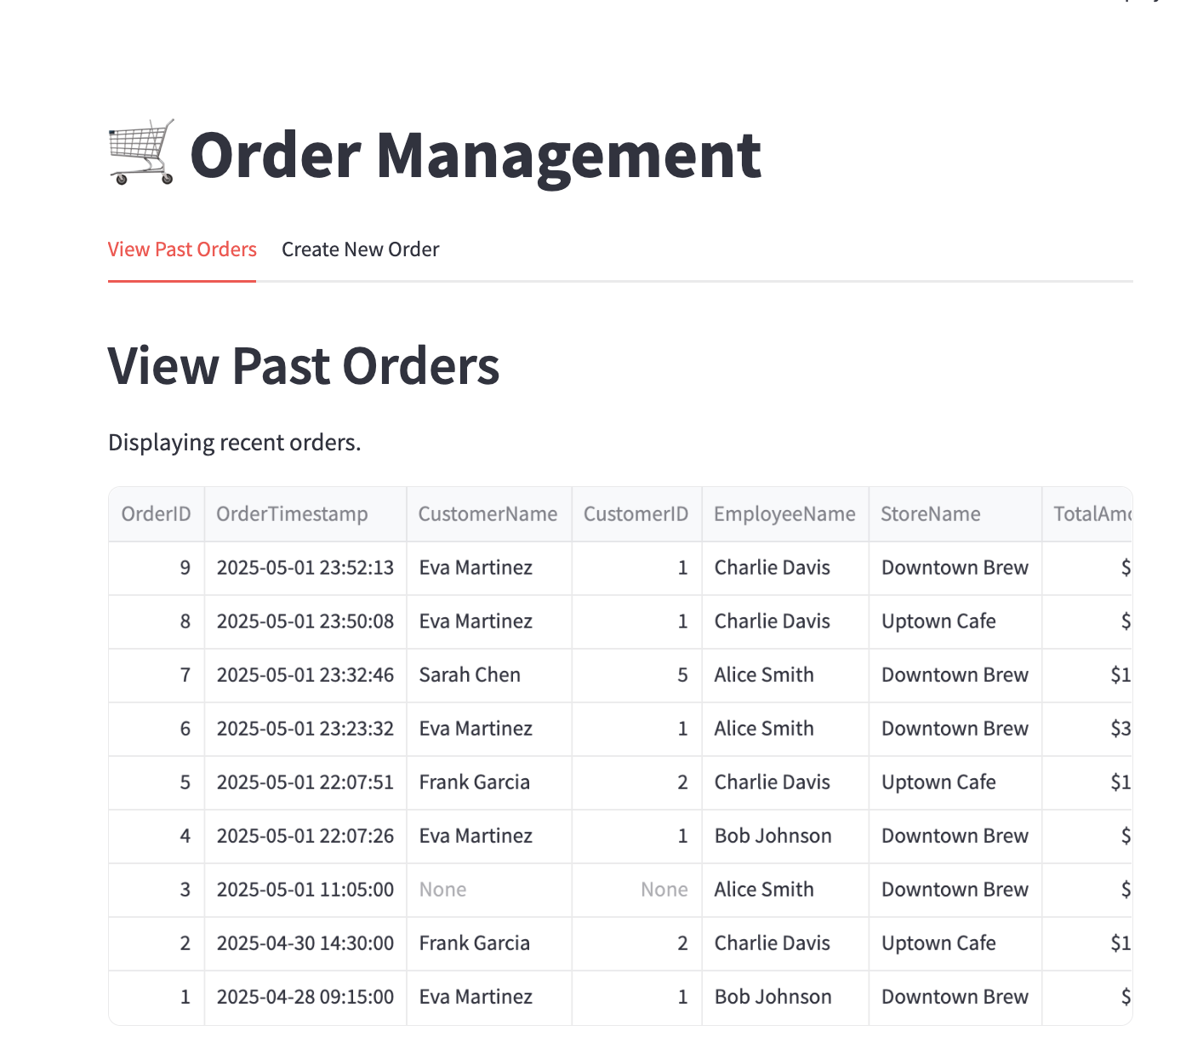
DB Concepts – Normalization
Level Achieved: 3NF / BCNF
How: PKs, Full Key Dependency, No Transitive Dependencies
Example: ProductName in Products, not repeated in OrderItems.
Example: StoreName in Stores, referenced via StoreID in Orders.
Benefits: Reduced Redundancy, Data Integrity, Update Efficiency.
Notes:
"Returning to database concepts, the schema design adheres to high normalization standards, achieving Third Normal Form and likely BCNF. This was accomplished by ensuring every table has a primary key, all data fields depend fully on that key, and avoiding situations where non-key fields depend on other non-key fields. For example, product names are stored only once in the Products table, not repeated in every order item. This minimizes data duplication and prevents inconsistencies when data needs updating."

Slide 14
DB Concepts – Integrity Enf.
Primary Keys (Unique Rows, e.g., OrderID)
Foreign Keys (Relationships, e.g., Orders.CustomerID -> Customers.CustomerID)
Defined Behaviors: ON DELETE RESTRICT, ON DELETE SET NULL
UNIQUE Constraints (e.g., Customers.Email)
NOT NULL Constraints (e.g., Products.Price)
CHECK Constraints (e.g., StockQuantity >= 0)
Procedural Logic (sp_ProcessOrder stock/point validation)
Notes:
Data integrity was a key focus, enforced through multiple layers. Primary keys ensure every record is unique. Foreign keys rigorously maintain the relationships between tables – for instance, preventing orders from being linked to non-existent employees using ON DELETE RESTRICT, while allowing customer deletion by setting past orders' CustomerID to NULL. Unique constraints prevent duplicate emails, NOT NULL ensures required fields have values, and CHECK constraints validate data ranges like non-negative prices. Finally, the sp_ProcessOrder procedure adds application-level integrity by validating stock and points before committing the transaction."

Slide 15
DB Concepts – Isolation
Environment: MySQL (InnoDB Engine)
Default Level: REPEATABLE READ
Provides: Good consistency (No Dirty/Non-Repeatable Reads).
Sufficient For: Most CRUD/Reporting tasks in this app.
Explicit Transactions: sp_ProcessOrder uses START TRANSACTION...COMMIT/ROLLBACK.
Ensures: Atomicity for critical multi-step order processing.
Notes:
"The system operates using MySQL's InnoDB engine, which defaults to the REPEATABLE READ isolation level. This level provides excellent consistency for this application, preventing common issues like dirty reads or non-repeatable reads during standard operations. While sufficient for most tasks, for the critical multi-step process of creating an order, I explicitly wrapped the logic within the sp_ProcessOrder stored procedure inside a database transaction using START TRANSACTION, COMMIT, and ROLLBACK via an error handler. This guarantees that the entire order process is atomic – it either completes fully or fails entirely, ensuring data consistency even if errors occur midway."

Slide 16
Takeaways
07
Section

Slide 17

Conclusion
Successfully built a functional Coffee Shop Management System.
Met project requirements for database objects, CRUD, and reporting.
Applied core database concepts (Normalization, Integrity, Transactions).
Demonstrated integration between Python/Streamlit UI and MySQL backend.
Notes:
"In conclusion, this project successfully delivered a working prototype of a coffee shop management system. It features a well-structured MySQL database with the required objects and complexity, and a functional Python Streamlit application providing full CRUD capabilities, complex order processing, and aggregated reporting. Key database design principles concerning normalization, integrity, and transaction management were implemented throughout. Thank you for your time."

